Slide 1
International Conference
on
Recent Trends in Electronics, Information and Communication Technology
(RTEICT-2019)
Genome Sequencing and Analysis on Cancer Codons
(Paper ID:449)
SHAILESH D, ANOOJA ALI, VISHWANATH R H, HARSHITHA K.B,
MANJUNATH C, SWETHA SIVAKUMAR
REVA UNIVERSITY
School of Computing and Information Technology
Bengaluru-560064

Slide 2
INTRODUCTION
Genome Sequencing in the field of Bioinformatics is quite an evolving application as all the information of an organism is carried on its DNA.
Sequencing and Analysis of genome helps in rapid clinical diagnosis and treatment of diseases and advanced scientific research.
In this paper, We increase the efficiency of finding mutations with primary techniques namely, indexing, pattern matching, sequence alignments and comparison of FASTA files to find out variation, leading to the increase in accuracy of finding cancer genome mutation.

Slide 3
OBJECTIVES
The accuracy of the Genome Analysis is quite unsubstantial and the incorrect diagnosis can lead to differing complications.
The solution for this drawback is the illustrative process in modules where each Algorithm analysis the mutated sequences and their comparative analysis is carried out.

Slide 4
FLOW DIAGRAM OF PROPOSED SYSTEM
Start
Load Dataset
Preprocessing
Boyer-Moore
Pattern Matching
Exact-Naive
Sequence Alignment
Needleman-Wunsch
RESULT
Mutation Detection
FASTA Visualization

Slide 5
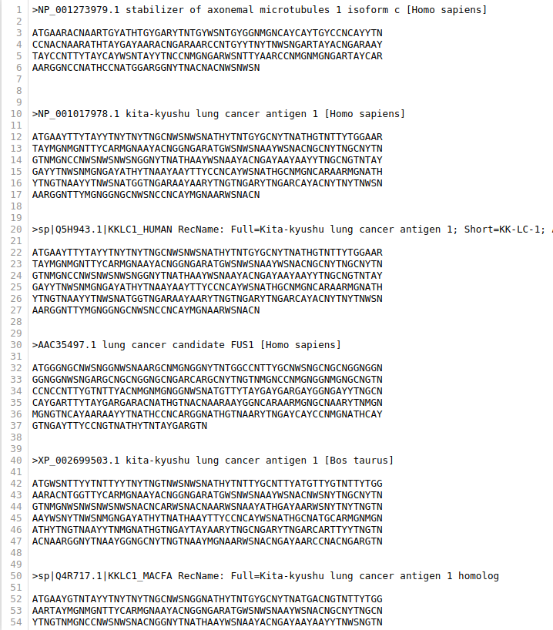
CANCER DATASET(fasta format)

Slide 6
PREPROCESSING
Boyer-Moore Algorithm
Boyer Moore Algorithm actually learns from character comparisons to skip pointless alignments.
It performs both alignment in left-to-right order and character comparisons in right-to-left order.
The working of character comparisons during mismatches is Alignments are skipped until mismatch becomes a match, or Pattern P moves past mismatched character.
Alignments are performed only during a character match among Pattern P and Text T.
Boyer-Moore depicts the exact positions of matched nucleotides during align and string search operations.

Slide 7
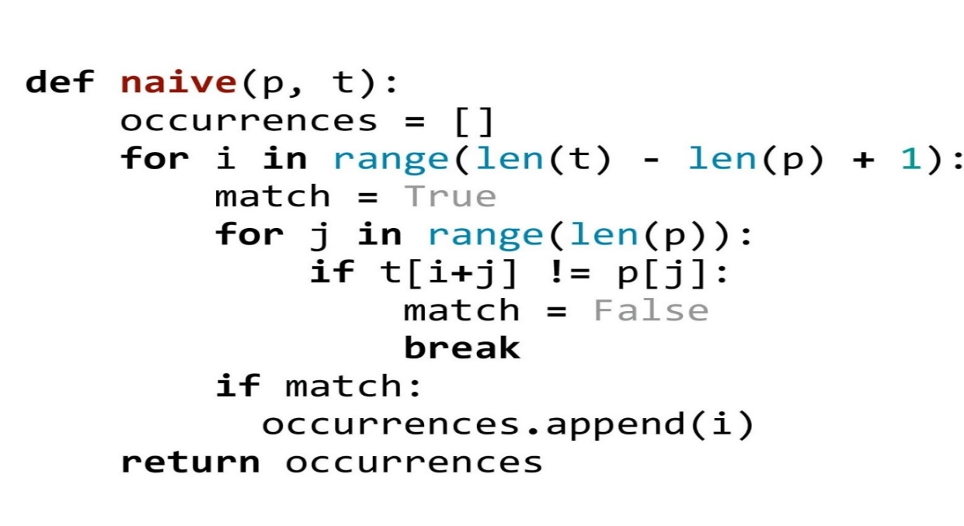
PATTERN MATCHING
Exact-Naïve Algorithm
The Algorithm depends on the length of the text sequence ‘N’ and pattern sequence ‘M’ such that N>M.
Pattern Matching loops until (N-M+1)times where the exact positions of the sequences are found out with the help of indexes, which are done during Preprocessing.
The Exact Location of the sequences and the matched sequences are appended together for the output.

Slide 8
Needleman-Wunsch Algorithm
SEQUENCE ALIGNMENT
The Algorithm works as Global Alignment where matches, mismatches, and gaps are considered as integer values. The matches are considered as -1, mismatches as -1 and gaps are considered as -2.
The Upward, Side-ward, and Diagonal Values are added accordingly with respect to their directions.
The Maximum value among the three values are assigned in to-be-filled blocks and the process continues till the end of the sequence in Score Matrix.
The Final Step is Traceback Method, where the maximum values are traced back from end to the begin of the sequence in Score Matrix.
The Gaps between the Traceback are considered as Mutated Nucleotide among the considered two sequences

Slide 9
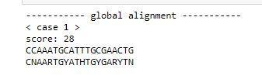
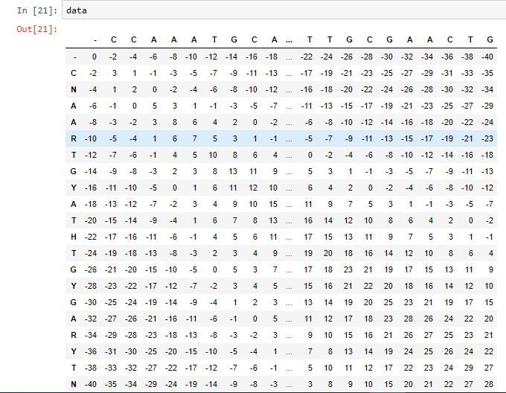
NEEDLEMAN WUNSCH IMPLEMENTATION RESULTS

Slide 10
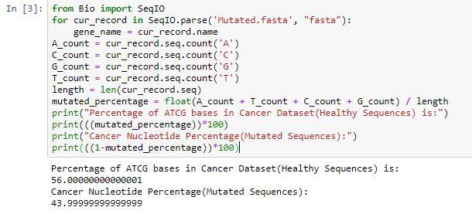
1.Mutation Detection:
RESULTS
Calculate number of Nucleotide Bases A,T,C,G present in Mutated.fasta(Cancer Dataset)
Calculate the length of total sequences in fasta
Calculate the mutated percentage i.e. Count of ATGC bases.
Calculate the percentage of nucleotides other than mutated percentage, which prints Cancer Nucleotide Percentage present in the dataset.

Slide 11

2.FASTA Visualization:
RESULTS(CONTINUED..)
FluentDNA is the DNA visualization tool used for visualization.
Every nucleotide bases will be assigned a color to visualize.
N(grey color) is assigned to every mutated nucleotide.

Slide 12
COMPARATIVE ANALYSIS OF ALGORITHMS(EXISTING v/s PROPOSED)
MODULES | ALGORITHMS | **ACCURACY | *RUNTIME(%%time)
PREPROCESSING | K-MER INDEXING | < 70% (Only Range of the mutation is found) | 33.6µs
 | BOYER-MOORE | >90% | 69.6µs
PATTERN MATCHING | APPROXIMATE MATCHING | 100% | 38.3 ms
 | EXACT-NAÏVE MATCHING | 100% | 181 µs
SEQUENCE ALIGNMENT | SMITH-WATERMAN | < 90% (Gaps are identified as mismatches) | 2ns (Considered alignment function for runtime)
 | NEEDLEMAN-WUNSCH | 100% (Scoring is integer not binary) | 0ns (Considered alignment function for runtime)
**Accuracy is our Primary Factor to be considered.
*When two algorithms are having same accuracy, Compare the RUN-TIME

Slide 13
CONCLUSION
The accuracy obtained after Proposed System Implementations during Genome Sequencing and Analysis varies Upto 20% from the existing system.
The primary purpose of sequencing one’s genome is to obtain information of medical value for future care.
Genomic sequencing can provide information on genetic variants that can lead to disease or can increase the risk of disease development, even in asymptomatic people.

Slide 14
REFERENCES
[1] C. Creighton and S. Hanash, “Mining gene expression databases for association rules,” Bioinformatics, vol. 19, no. 1, pp. 79-86, 2013.
[2] Pritchard L, White JA and Birch PR, “Genome Diagram: a Python package for the visualization of large-scale genomic data”, Bioinformatics, 22, 616-617, 2014.
[3] Cock PJ, Fields CJ, Goto N, Heuer ML and Rice PM,” The Sanger FASTQ file format for sequences with quality scores, and the Solexa/Illumina FASTQ variants”. Nucleic Acids Res., 38, 1767-1771, 2009.
[4]. Baeza-Yates, R.; Navarro, G. (June 1996). "A faster algorithm for approximate string matching." In Dan Hirschberg; Gene Myers (eds.). Combinatorial Pattern Matching (CPM'96), LNCS 1075. Irvine, CA. Pp. 1–23.
[5]. Smith, Temple F. & Waterman, Michael S. (1981). "Identification of Common Molecular Subsequences." Journal of Molecular Biology. 147 (1): 195–197. CiteSeerX 10.1.1.63.2897. doi:10.1016/0022-2836(81)90087-5. PMID 7265238.
[6]. Needleman, Saul B. & Wunsch, Christian D. (1970). "A general method applicable to the search for similarities in the amino acid sequence of two proteins." Journal of Molecular Biology. 48 (3): 443–53. doi:10.1016/0022-2836(70)90057-4. PMID 5420325

Slide 15
THANK YOU

